Slide 1


SKIN BURN IMAGE DETECTION AND CLASSIFICATION
Made By:
Lakshita(19CSU166), Madhur(19csu169), Mitali(19CSU177), Nancy(19CSU403)

Slide 2
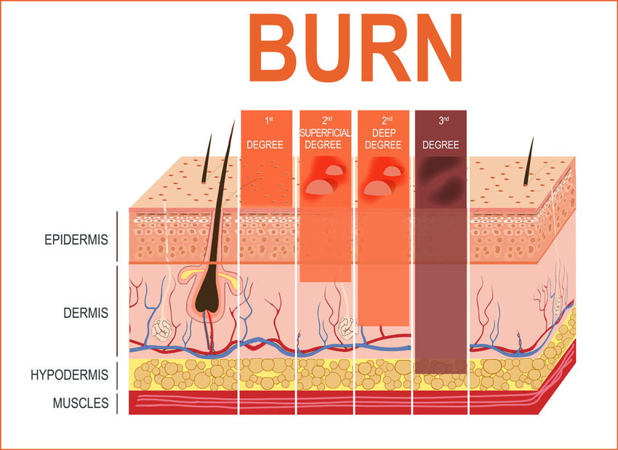
Skin Burn is a vital skin problem which is often ignored and not taken care of in its early stages, this is due to the unawareness regarding the detection of different degrees of skin burn.
Our project aims to propose a solution for the same. With the help of image classification our model will train images of different degrees of skin burn and will help the user identify the degree of skin burn they are suffering with.
PROBLEM STATEMENT

Slide 3

PURPOSE
Burn is one of the serious public health problems. Usually, burn diagnoses are based on expert medical and clinical experience and it is necessary to have a medical or clinical expert to conduct an examination in restorative clinics or at emergency rooms in hospitals.
But sometimes a patient may have a burn where there is no specialized facility available, and in such a case a computerized automatic burn assessment tool may aid diagnosis.
Burn area, depth, and location are the critical factors in determining the severity of burns.
The objective of the project is to develop the feature extraction model to classify the burn.

Slide 4
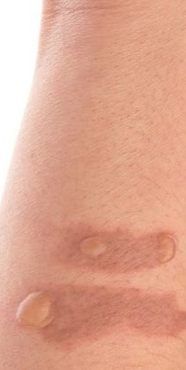
RELATED WORK
In the paper of Badea et al.[2], the author has proposed a method for burn image detection. As per the properties of an entire encompassing patch, they have applied the pixel-wise method. This method is computationally expensive and also sensitive to noise. Therefore, their classifier is not able to provide optimized results. It also requires supplemental medical information which supports for classification.
Multispectral imaging (MSI) is implemented by Li et al.[6] to diagnose burn injury. It assists burn surgeons for classifying burn tissue for the burn debridement surgery. Their algorithm significantly increased burn model classification accuracy.

Slide 5
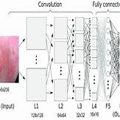
RELATED WORK
In a second deep-learning-based study, the segmentation of skin burns was accomplished by using Otsu’s method, and feature vectors were extracted by using statistical methods. A deep convolutional neural network was used to estimate burn depth [8] with 79.4% accuracy. One of the disadvantages of applying deep learning to the problem of classifying skin burns is the requirement of collecting data from a very large number of patients.
Sabeena and Kumar have given a careful way using SVM for burn identification and its segmentation [8]. The main idea behind their work is to get well burn or acted-on process. Their system uses a range of methods for the image acquiring and pre-processing. It clearly outlines and extracts the burn from the images, but the accuracy is not up to the mark.

Slide 6
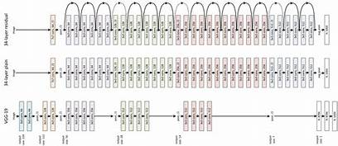
Step 1: Import Dataset
Step 2: Use a CNN Model to Classify Burn Wounds (using Transfer Learning)
Step 3: Output percentage of skin burned with respective class
APPROACH
RESNET50 Architecture

Slide 7
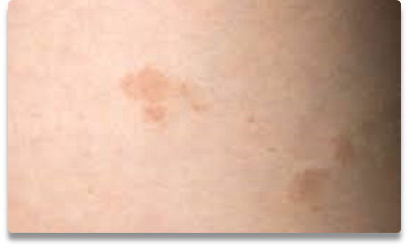
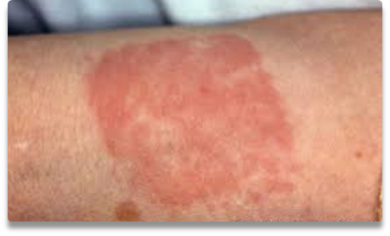
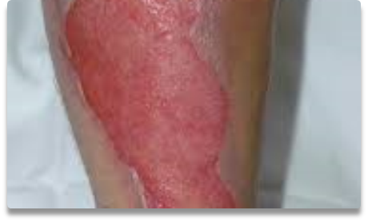
DEGREES OF BURN
1ST DEGREE
2ND DEGREE
3RD DEGREE
Affect the epidermis and the dermis (lower layer of skin).
Affect only the epidermis, or outer layer of skin.
Go through the dermis and affect deeper tissues.

Slide 8
Models Applied
01
02
03
04
BASIC CNN
RESNET 50
VGG 19
INCEPTION NET

Slide 9

BASIC CNN
A Convolutional Neural Network, also known as CNN or ConvNet, is a class of neural networks that specializes in processing data that has a grid-like topology, such as an image.
A CNN typically has three layers: a convolutional layer, a pooling layer, and a fully connected layer.
This layer often contains input vectors, such as an image, filters, such as a feature detector, and output vectors, such as a feature map. The image is abstracted to a feature map, also known as an activation map, after passing through a convolutional layer.

Slide 10
Loss: Categorical Cross Entropy
Optimizer: Adam
Training Accuracy: 66.6%
Validation Loss: 63.6%
Test Accuracy: 66.67%
Training Loss: 63.5%

Slide 11
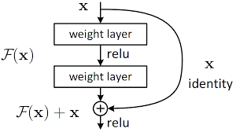
RESNET 50
Deep residual networks like the popular ResNet-50 model is a convolutional neural network (CNN) that is 50 layers deep.
A Residual Neural Network (ResNet) is an Artificial Neural Network (ANN) of a kind that stacks residual blocks on top of each other to form a network.
These additional layers help solve complex problems more efficiently as the different layers could be trained for varying tasks to get highly accurate results.

Slide 12
Loss: Categorical Cross Entropy
Optimizer: Adam
Training Accuracy: 62.3%
Validation Loss: 75%
Test Accuracy: 71.6%
Training Loss: 90.7%

Slide 13
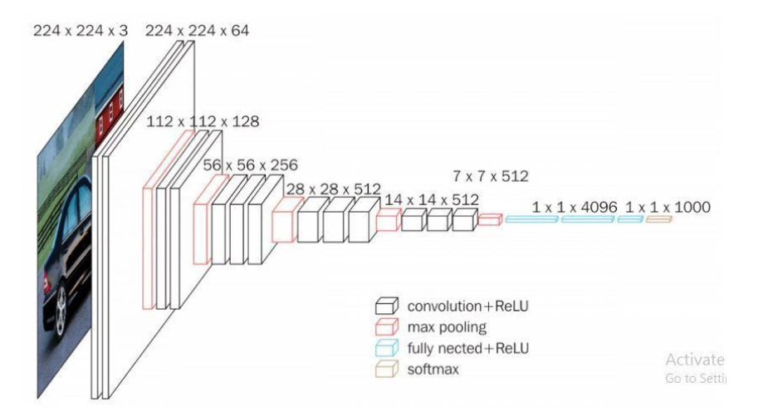
VGG 16
VGG16 is object detection and classification algorithm which is able to classify 1000 images of 1000 different categories.
The 16 in VGG16 refers to 16 layers that have weights. In VGG16 there are thirteen convolutional layers, five Max Pooling layers, and three Dense layers which sum up to 21 layers but it has only sixteen weight layers i.e., learnable parameters layer.
One of the popular algorithms for image classification.
.

Slide 14
Loss: Categorical Cross Entropy
Optimizer: Adam
Training Accuracy: 92.1%
Validation Loss: 13.1%
Test Accuracy: 96.3%
Training Loss: 17.7%

Slide 15
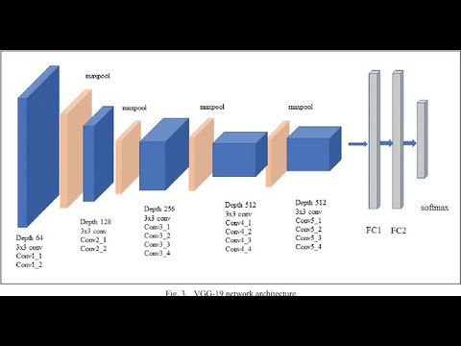
VGG 19
VGG19 is a variant of VGG model which in short consists of 19 layers (16 convolution layers, 3 Fully connected layer, 5 MaxPool layers and 1 SoftMax layer).
Used just as a good classification architecture for many other datasets and as the authors made the models available to the public they can be used as is or with modification for other similar tasks also.
Transfer learning : can be used for facial recognition tasks also.
weights are easily available with other frameworks like keras so they can be tinkered with and used for as one wants.
.

Slide 16
Loss: Categorical Cross Entropy
Optimizer: Adam
Training Accuracy: 94.2%
Validation Loss: 11.38%
Test Accuracy: 96.84%
Training Loss: 71.6 %

Slide 17
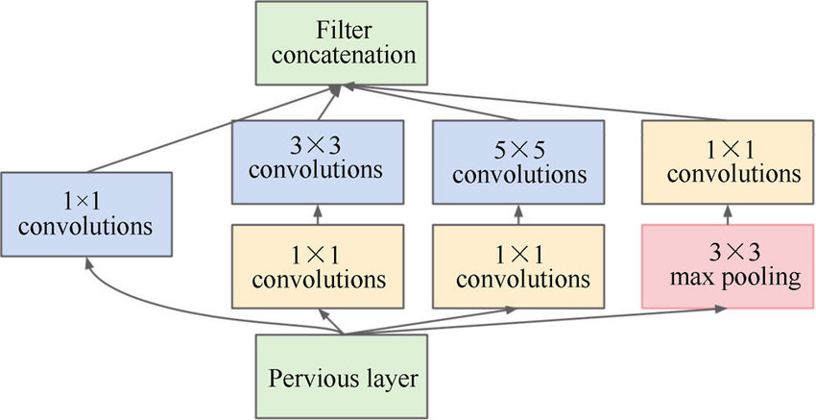
INCEPTION NET
An inception network is a deep neural network with an architectural design that consists of repeating components referred to as Inception modules.
An Inception Module consists of the following components:
Input layer
1x1 convolution layer
3x3 convolution layer
5x5 convolution layer
Max pooling layer
Concatenation layer

Slide 18
Loss: Categorical Cross Entropy
Optimizer: Adam
Training Accuracy: 94.6%
Validation Loss: 31.6%
Test Accuracy: 94.81%
Training Loss: 41.96%

Slide 19
Conclusion
The model implementation was done through Resent50, Basic CNN, Inception V3 and Vgg16 and 19. Images were imported after transformation and every model was run for 25 epoch values.
The Vgg16 model gave the highest accuracy of 96.3%, followed by Inception Net with an accuracy of 94.8%.

Slide 20
Increase accuracy of the models implemented to predict more efficient results.
Future Work
1
Deploy model for further usage.
2
4
Research paper to showcase the work done.
3

Slide 21
Thank you!

